Slide 1
How to deliver a lesson on eAlpha through Zoom
Notes:
Good morning, thank you for attending Alpha Publishing’s presentation on No internet, No problem – our solution to schools’ poor internet connectivity in many regions in which we operate.

Slide 2
Get the Zoom app from:
App Store for iOS
Google Play Store for Android
Microsoft Store for Microsoft
Notes:
Good morning, thank you for attending Alpha Publishing’s presentation on No internet, No problem – our solution to schools’ poor internet connectivity in many regions in which we operate.

Slide 3
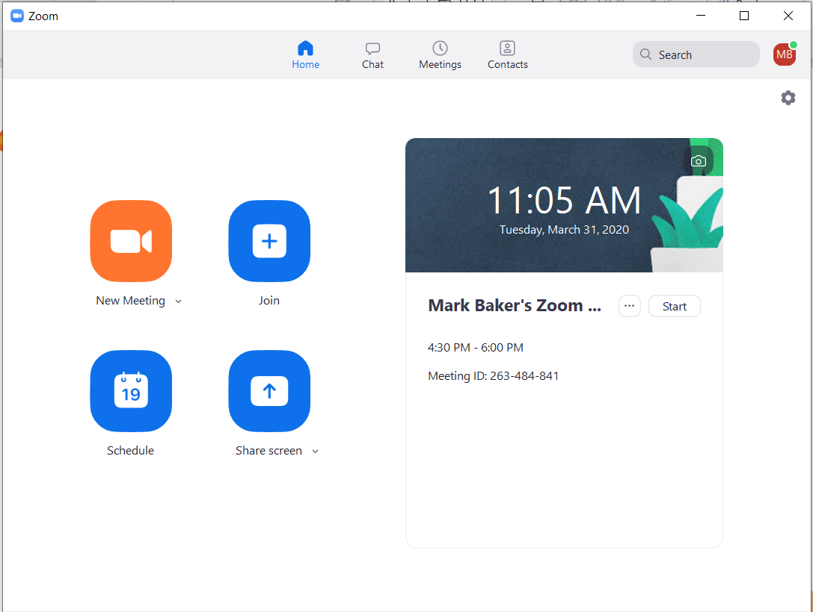
Open the Zoom app and create a new account for Zoom (if you don’t have one already) and login.
Select New Meeting.
Notes:
Good morning, thank you for attending Alpha Publishing’s presentation on No internet, No problem – our solution to schools’ poor internet connectivity in many regions in which we operate.

Slide 4
Click on Invite at the bottom of the screen
Notes:
Good morning, thank you for attending Alpha Publishing’s presentation on No internet, No problem – our solution to schools’ poor internet connectivity in many regions in which we operate.

Slide 5
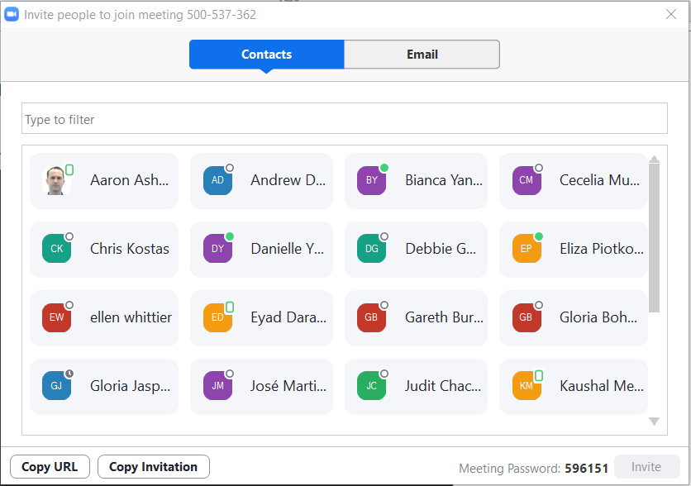
You can invite students to your zoom session by:
Clicking on the Copy URL and then pasting it in an email to your students or in a document on Google Classroom or in a school blog.
Clicking on Copy invitation and then pasting it in an email to your students or in a document on Google Classroom or in a school blog.
If your students have requested to be your contact on Zoom then they will appear in your list of contacts and you can click on their names to invite them to the meeting.
1
2
3
Notes:
Good morning, thank you for attending Alpha Publishing’s presentation on No internet, No problem – our solution to schools’ poor internet connectivity in many regions in which we operate.

Slide 6
Click on Manage Participants at the bottom of the screen.
Notes:
Good morning, thank you for attending Alpha Publishing’s presentation on No internet, No problem – our solution to schools’ poor internet connectivity in many regions in which we operate.

Slide 7
Once your students join your meeting you will see them in the Participants window
Notes:
Good morning, thank you for attending Alpha Publishing’s presentation on No internet, No problem – our solution to schools’ poor internet connectivity in many regions in which we operate.

Slide 8
Click on Share Screen at the bottom of the screen
Notes:
Good morning, thank you for attending Alpha Publishing’s presentation on No internet, No problem – our solution to schools’ poor internet connectivity in many regions in which we operate.

Slide 9
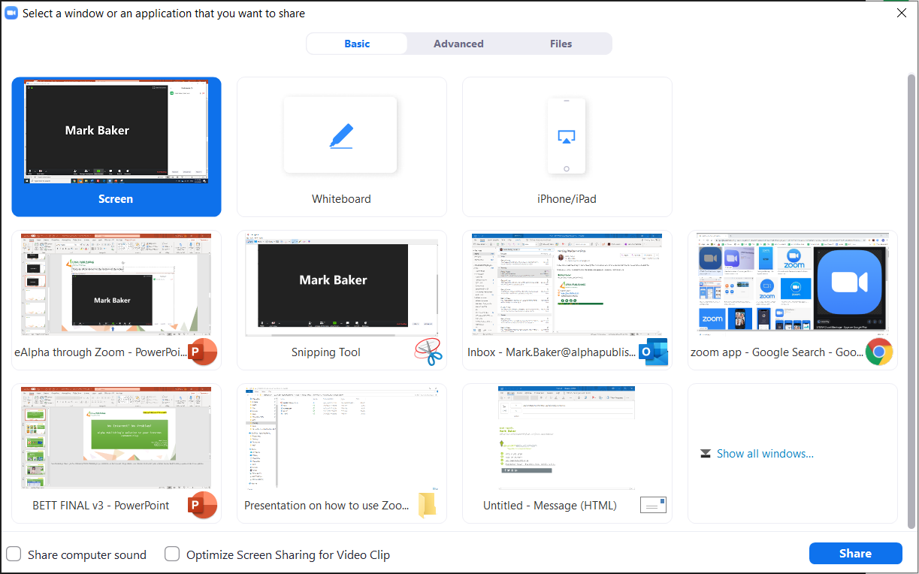
Select Screen
Notes:
Good morning, thank you for attending Alpha Publishing’s presentation on No internet, No problem – our solution to schools’ poor internet connectivity in many regions in which we operate.

Slide 10
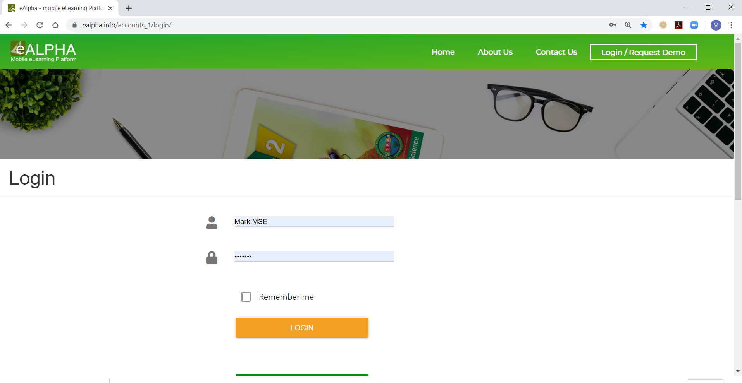
Go to your browser window (for example Chrome) and go to www.ealpha.info and login into eAlpha
Notes:
Good morning, thank you for attending Alpha Publishing’s presentation on No internet, No problem – our solution to schools’ poor internet connectivity in many regions in which we operate.

Slide 11
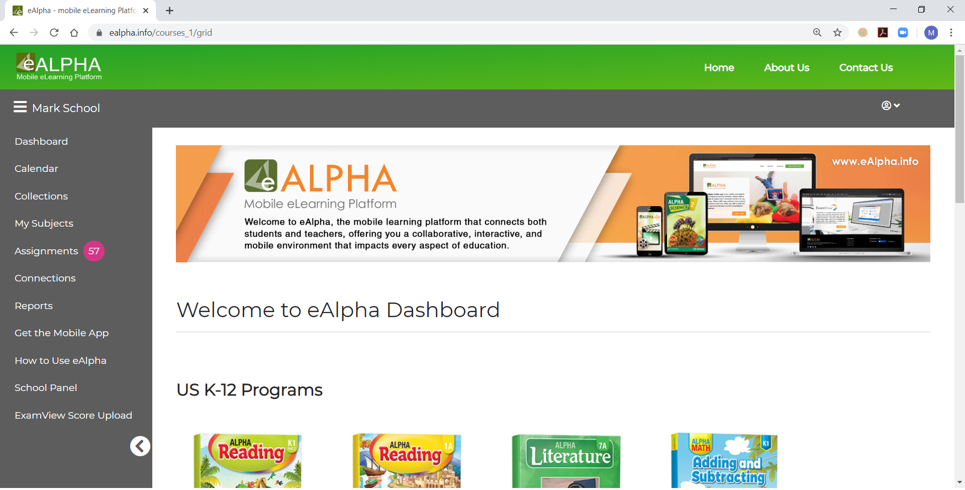
You can now show the lessons within eAlpha and your students will see the lessons. You can use your audio to speak to the students and they can use their audio to speak to you.
Notes:
Good morning, thank you for attending Alpha Publishing’s presentation on No internet, No problem – our solution to schools’ poor internet connectivity in many regions in which we operate.

Slide 12
Other useful features in Zoom to present your lessons:
You can mute the students microphones to stop them speaking over you during a lesson. Click on the microphone icon next to the student’s name and select mute. You can also choose mute all to mute all the students at once.
Notes:
Good morning, thank you for attending Alpha Publishing’s presentation on No internet, No problem – our solution to schools’ poor internet connectivity in many regions in which we operate.

Slide 13
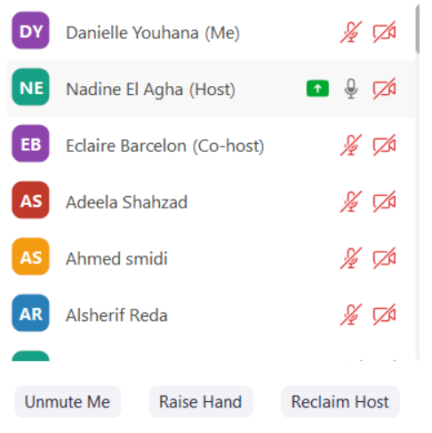
1. Select Chat at the bottom of the screen
2. You can now see the chat box – here you and the students can send messages to each other during the lesson
3.Students can also raise their hands
3
2
1
Notes:
Good morning, thank you for attending Alpha Publishing’s presentation on No internet, No problem – our solution to schools’ poor internet connectivity in many regions in which we operate.

Slide 14
1. You can record the session by clicking the Record button at the bottom of the screen.
2. Once you click End Meeting at the end of the lesson, the recording will download to your computer and you can then send it onto students who could not attend your lesson.
1
2
Notes:
Good morning, thank you for attending Alpha Publishing’s presentation on No internet, No problem – our solution to schools’ poor internet connectivity in many regions in which we operate.

Slide 15
To access the online whiteboard feature in Zoom – click on Share Screen at the bottom of the screen
Notes:
Good morning, thank you for attending Alpha Publishing’s presentation on No internet, No problem – our solution to schools’ poor internet connectivity in many regions in which we operate.

Slide 16
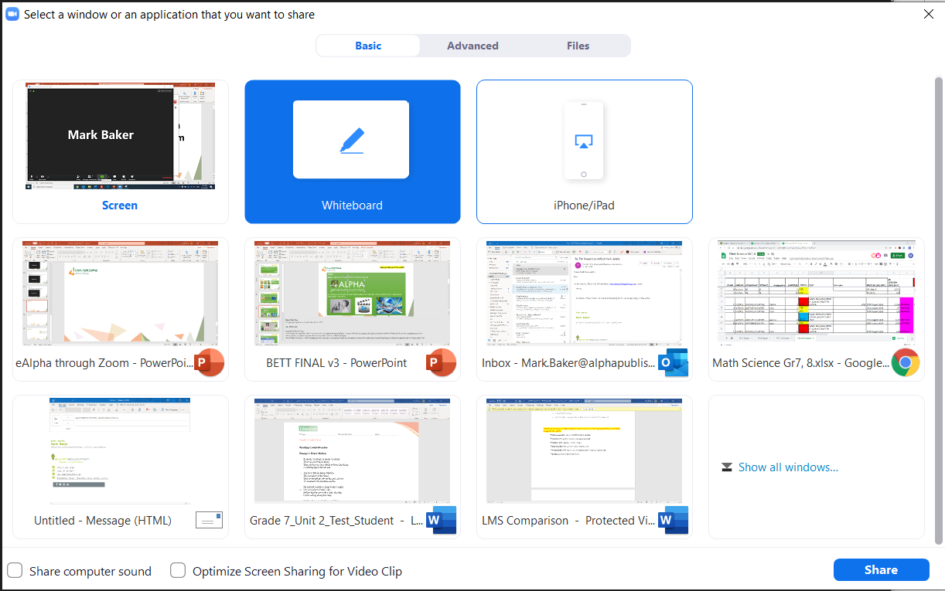
Select Whiteboard
Notes:
Good morning, thank you for attending Alpha Publishing’s presentation on No internet, No problem – our solution to schools’ poor internet connectivity in many regions in which we operate.

Slide 17
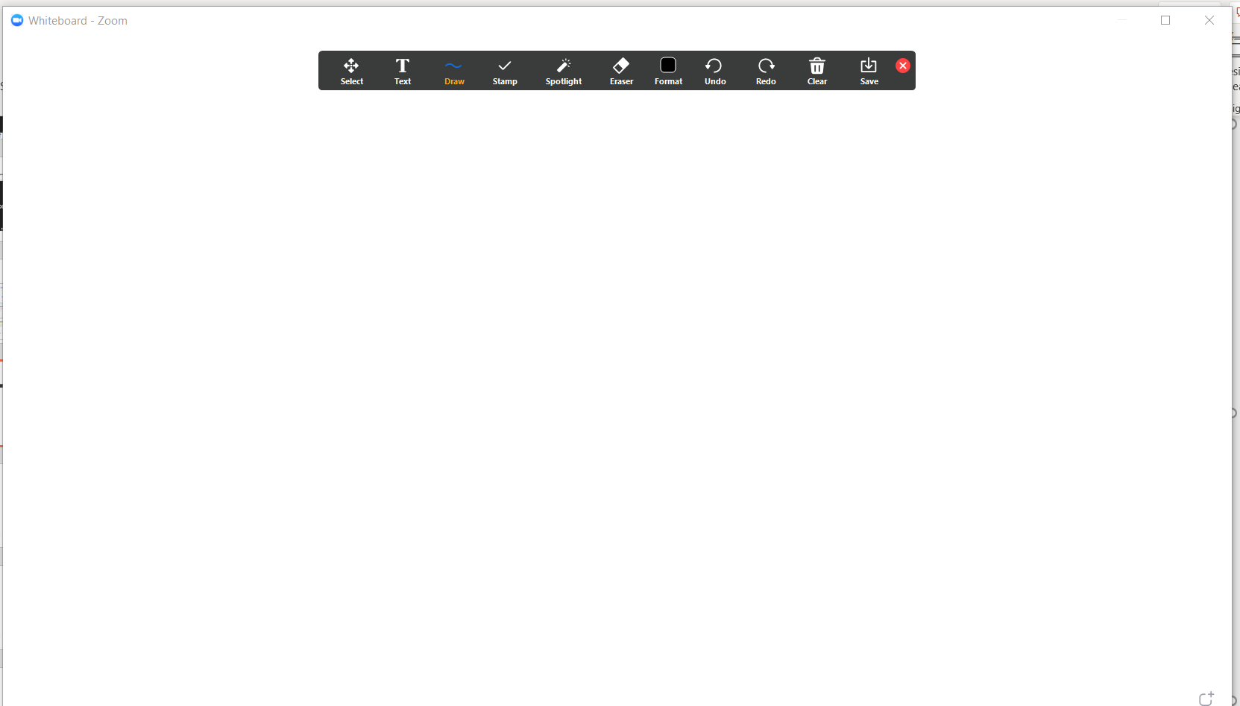
The whiteboard has a toolbar containing all the icons for using it with your students.
Notes:
Good morning, thank you for attending Alpha Publishing’s presentation on No internet, No problem – our solution to schools’ poor internet connectivity in many regions in which we operate.

Slide 18
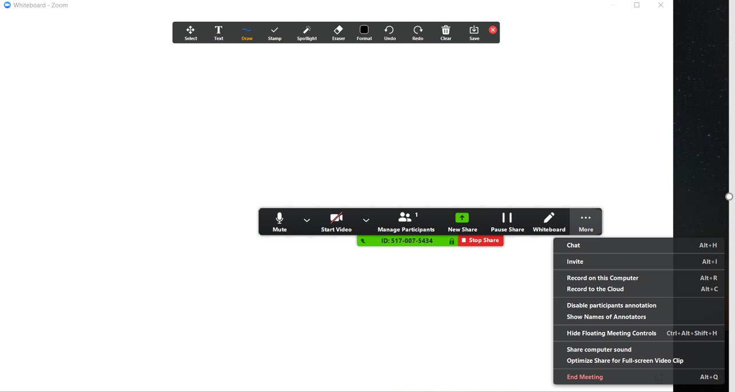
For the teacher to use and share the whiteboard options with the students; she/he can use many of the options below and can Disable and Enable students to write on the whiteboard

Slide 19
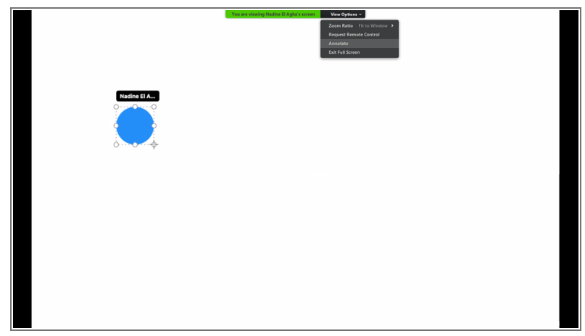
For the student to use the whiteboard, they need to move their mouse on their screens, a bar will appear with View Options, click it and choose Annotate
Notes:
Good morning, thank you for attending Alpha Publishing’s presentation on No internet, No problem – our solution to schools’ poor internet connectivity in many regions in which we operate.

