Slide 1
To deliver a lesson on eAlpha
Notes:
Good morning, thank you for attending Alpha Publishing’s presentation on No internet, No problem – our solution to schools’ poor internet connectivity in many regions in which we operate.

Slide 2
Google Hangouts is one of the best platforms for video calls, conference meetings and even small-scale webinars.
If on a desktop or laptop device, follow the link: https://hangouts.google.com/.
If on a mobile device, grab the Hangouts Android or iOS app.
Notes:
Good morning, thank you for attending Alpha Publishing’s presentation on No internet, No problem – our solution to schools’ poor internet connectivity in many regions in which we operate.

Slide 3
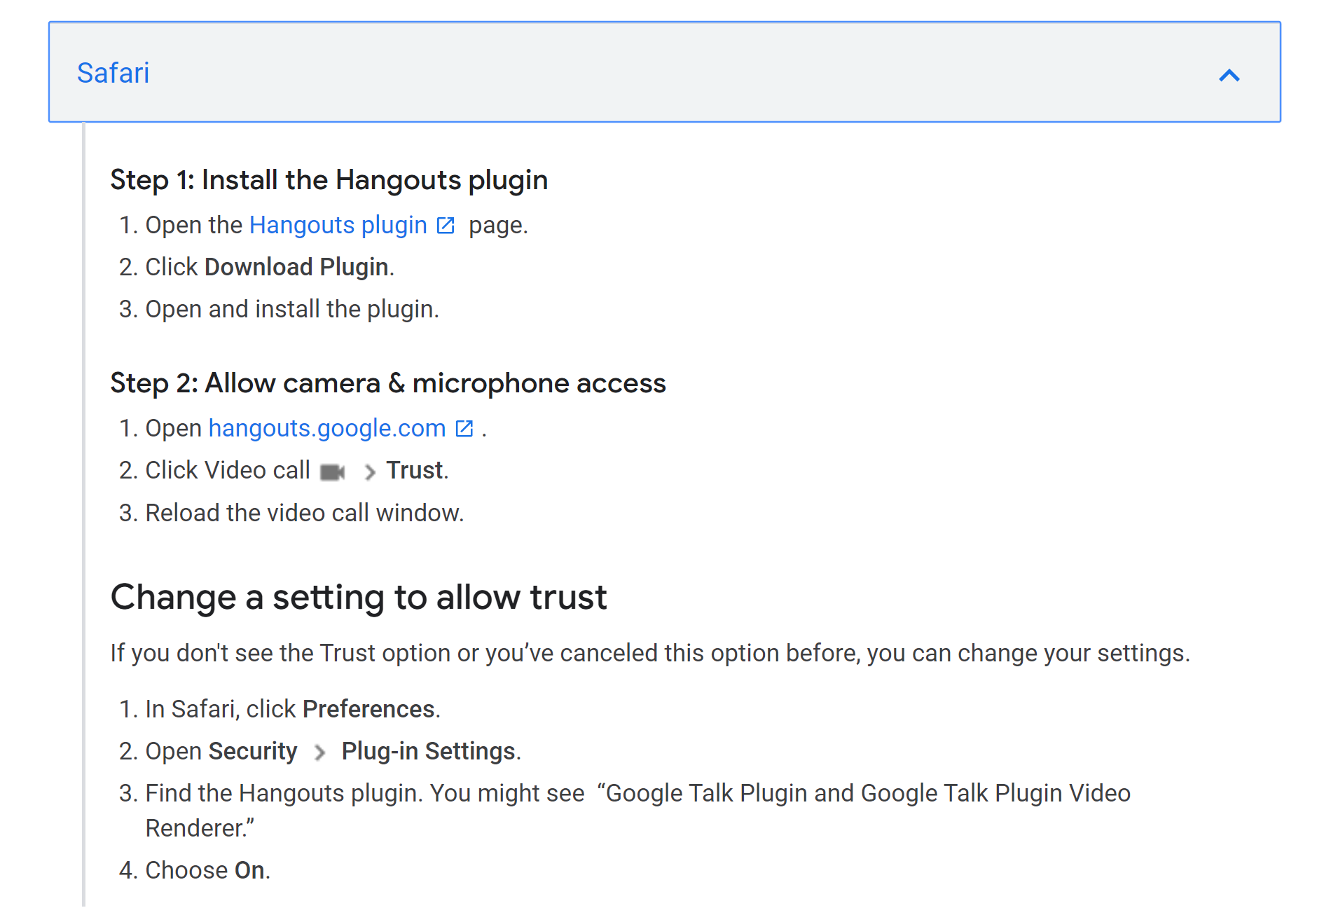
For Safari Browser
Notes:
Good morning, thank you for attending Alpha Publishing’s presentation on No internet, No problem – our solution to schools’ poor internet connectivity in many regions in which we operate.

Slide 4
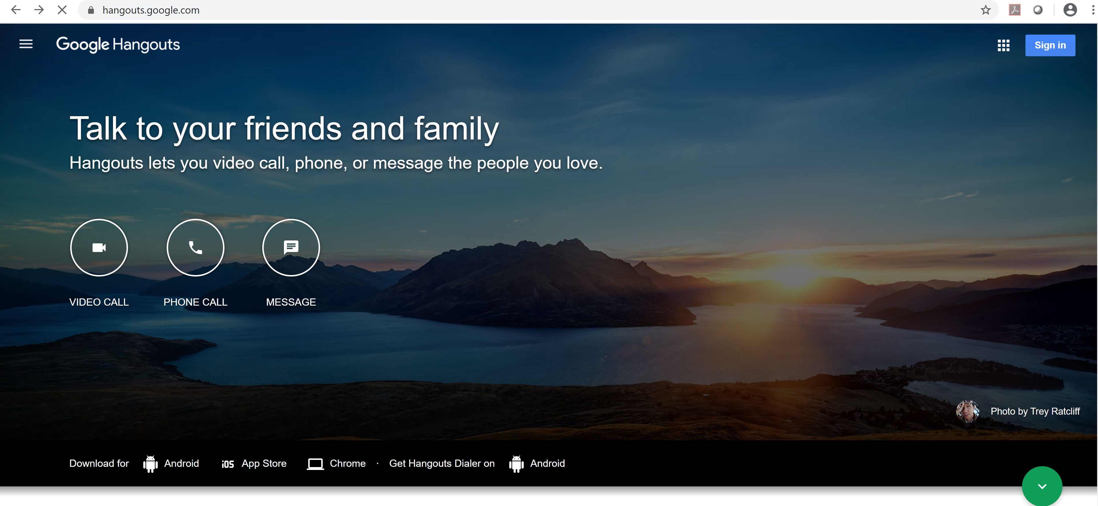
Open the google hangout and login with your Gmail account, if you don’t have one already create a new account.
Notes:
Good morning, thank you for attending Alpha Publishing’s presentation on No internet, No problem – our solution to schools’ poor internet connectivity in many regions in which we operate.

Slide 5
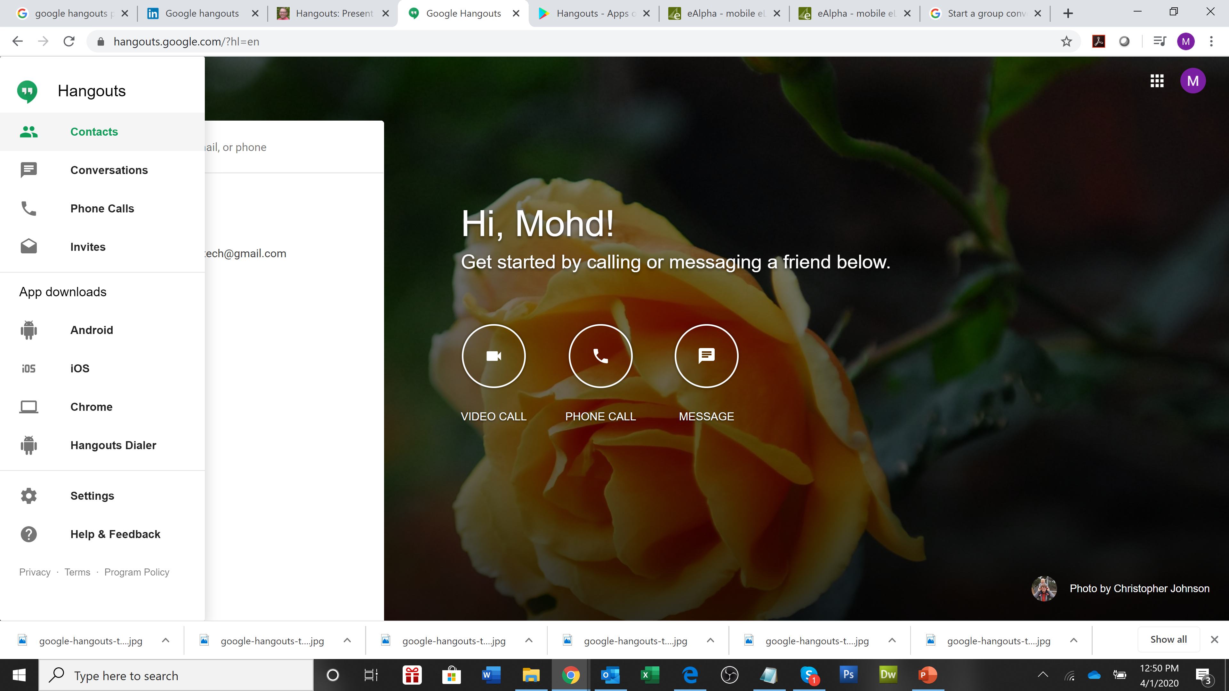
You can select the users from your Contacts.
You can invite others by selecting Invites from the menu.
Notes:
Good morning, thank you for attending Alpha Publishing’s presentation on No internet, No problem – our solution to schools’ poor internet connectivity in many regions in which we operate.

Slide 6
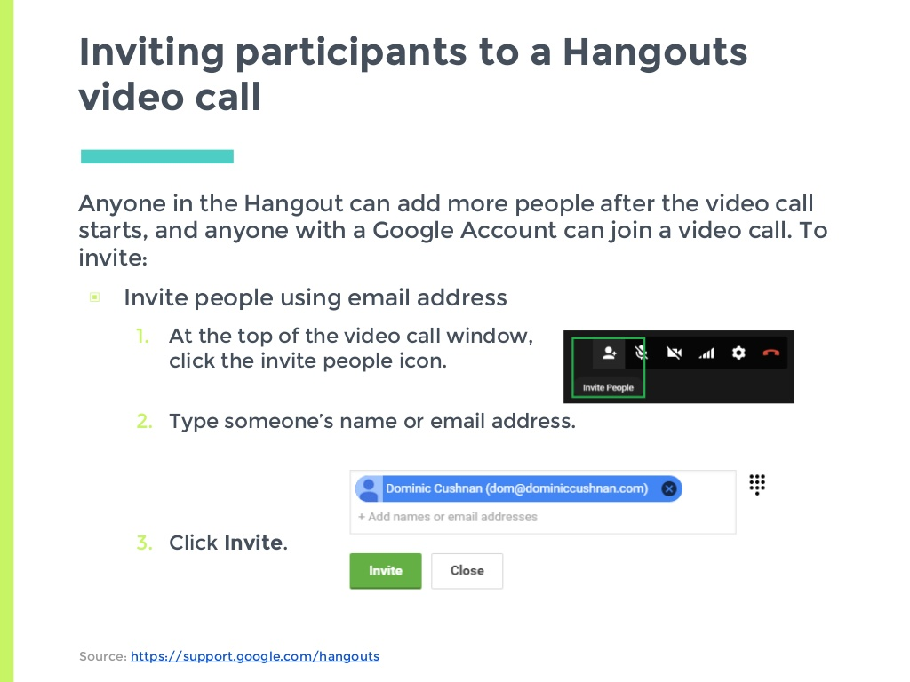
Notes:
Good morning, thank you for attending Alpha Publishing’s presentation on No internet, No problem – our solution to schools’ poor internet connectivity in many regions in which we operate.

Slide 7
Notes:
Good morning, thank you for attending Alpha Publishing’s presentation on No internet, No problem – our solution to schools’ poor internet connectivity in many regions in which we operate.

Slide 8
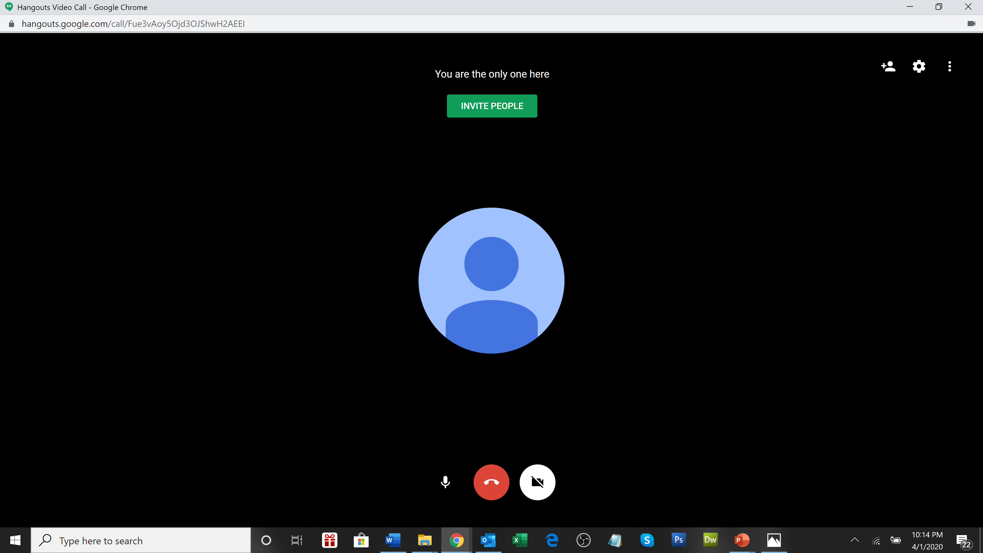
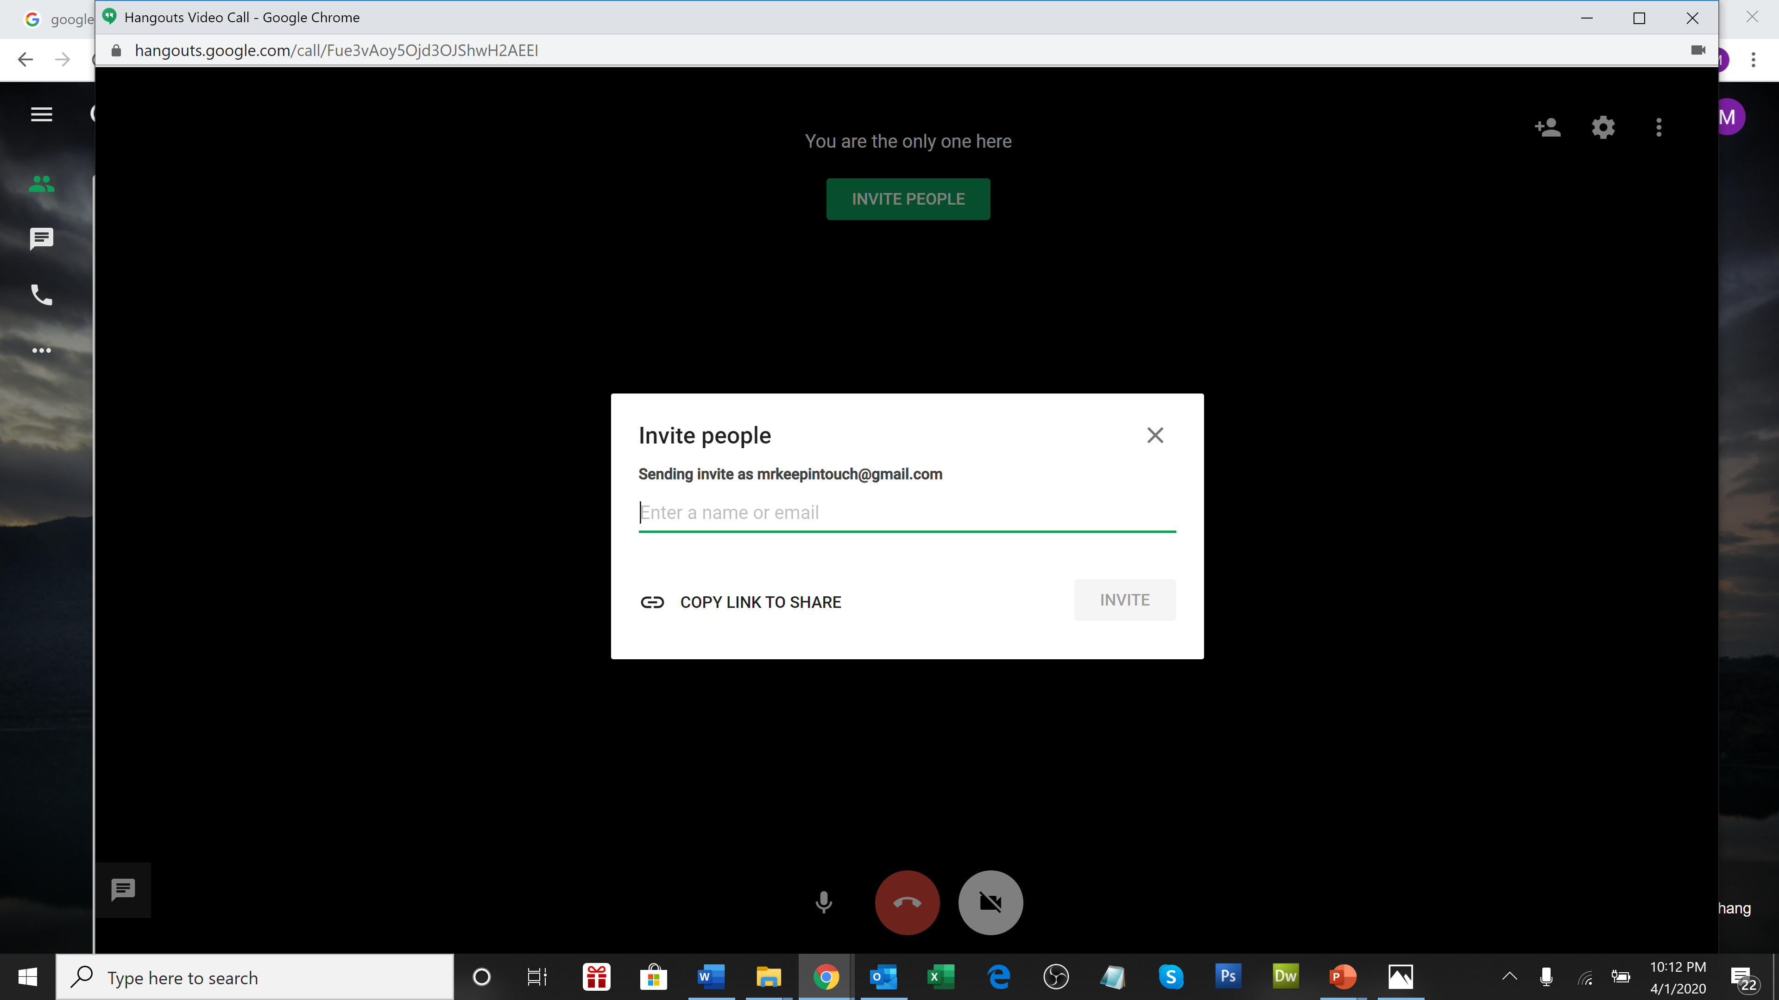
Click on Invite at the top of the screen and copy the link
Notes:
Good morning, thank you for attending Alpha Publishing’s presentation on No internet, No problem – our solution to schools’ poor internet connectivity in many regions in which we operate.

Slide 9
Click on Invite at the top of the screen and copy the link
Notes:
Good morning, thank you for attending Alpha Publishing’s presentation on No internet, No problem – our solution to schools’ poor internet connectivity in many regions in which we operate.

Slide 10
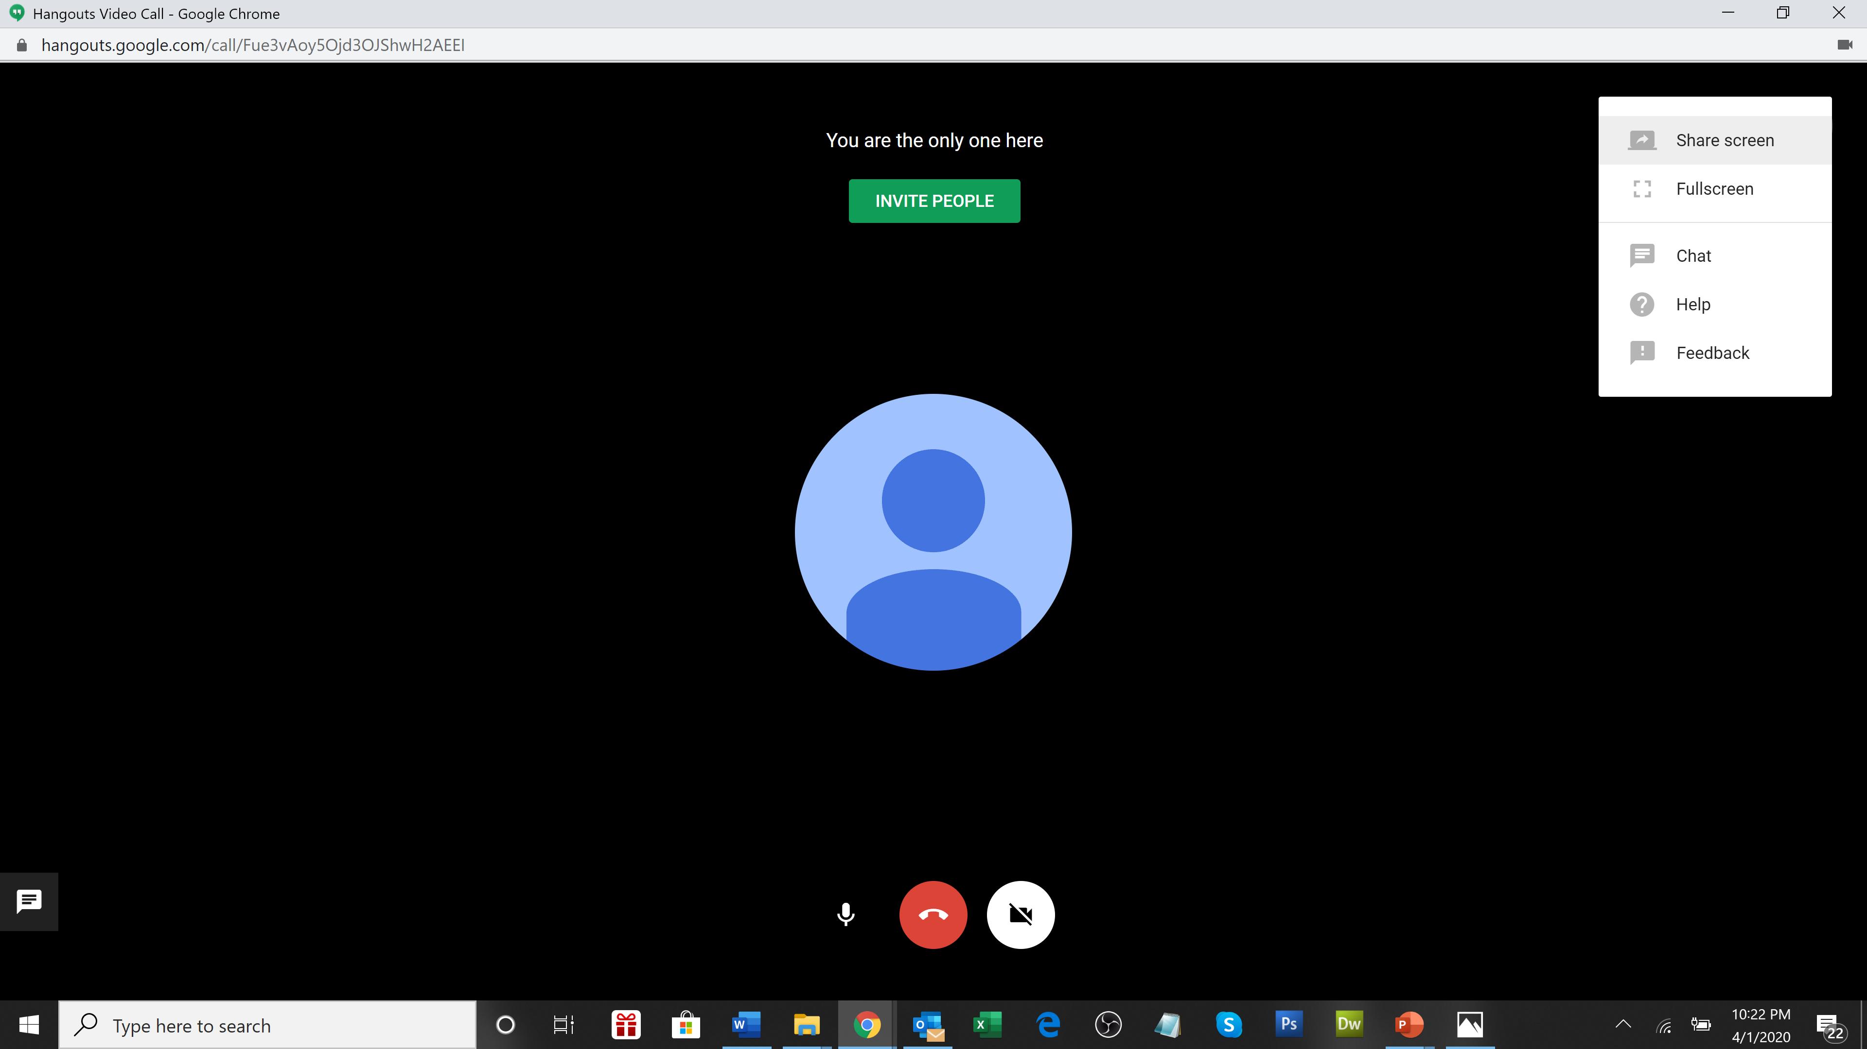
Click on Share screen from the right menu to share the screen
Notes:
Good morning, thank you for attending Alpha Publishing’s presentation on No internet, No problem – our solution to schools’ poor internet connectivity in many regions in which we operate.

Slide 11
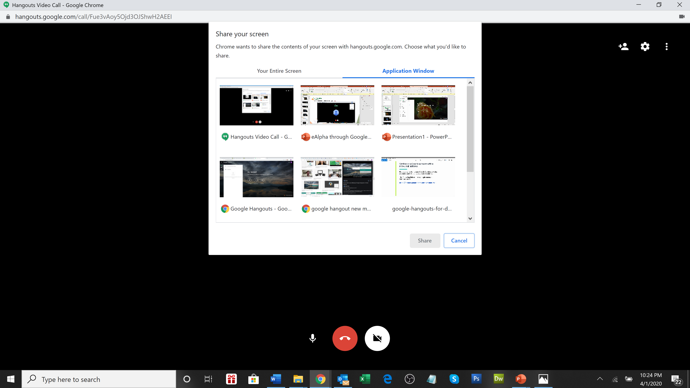
Click on Application Window to share the single screen
Notes:
Good morning, thank you for attending Alpha Publishing’s presentation on No internet, No problem – our solution to schools’ poor internet connectivity in many regions in which we operate.

Slide 12
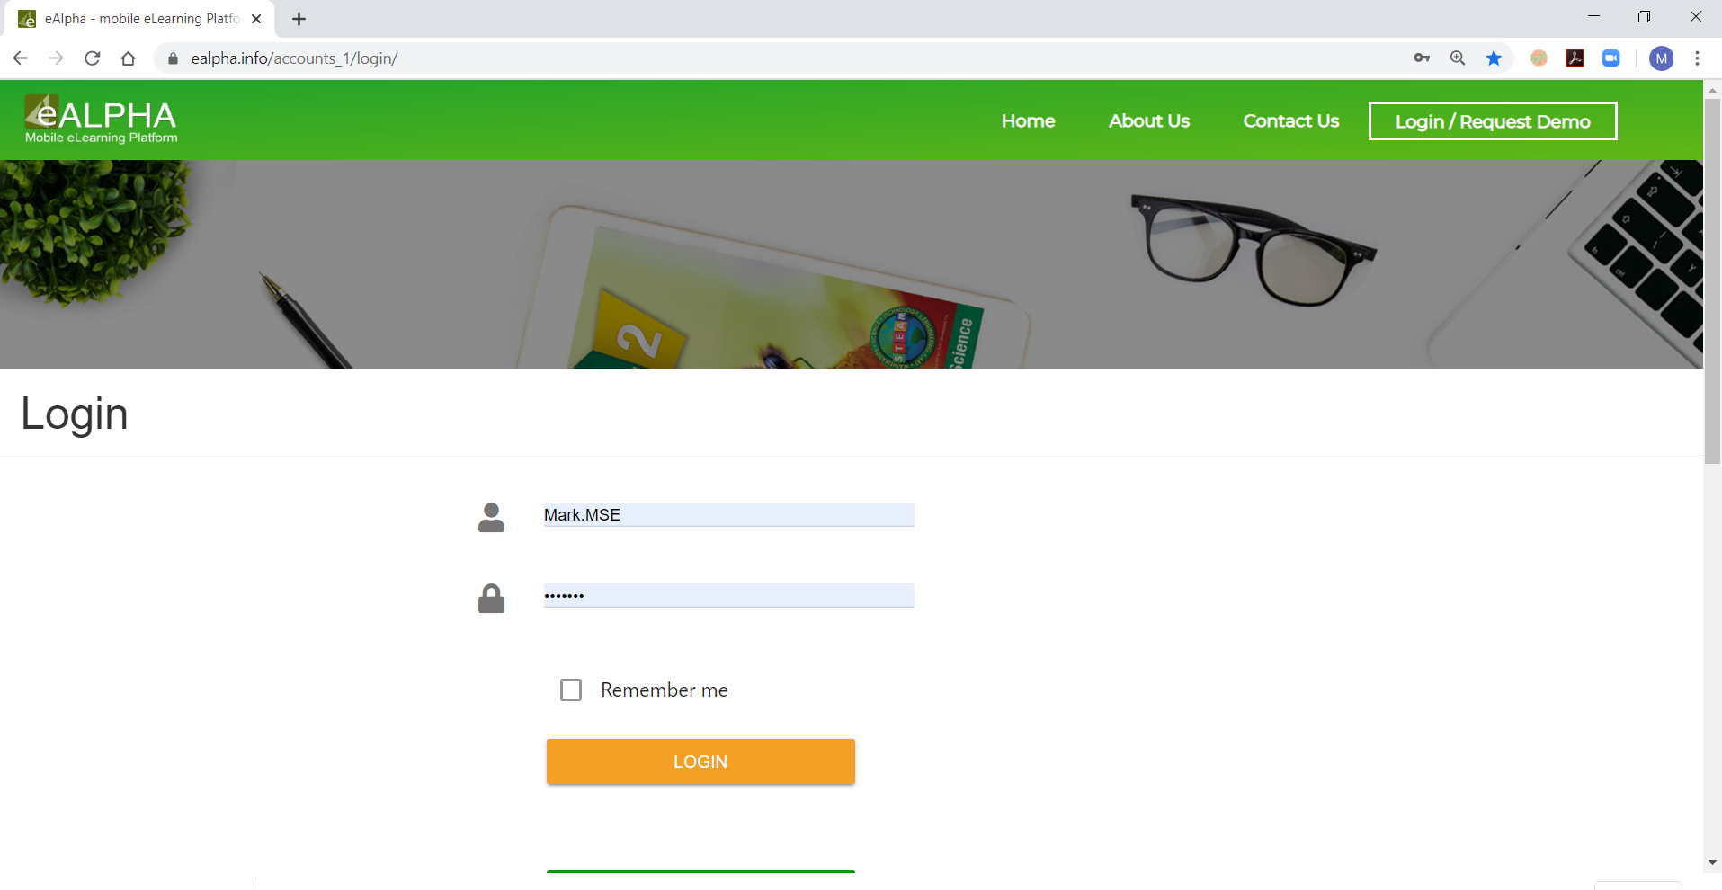
Go to your browser window (for example Chrome) and go to www.ealpha.info and login into eAlpha
Notes:
Good morning, thank you for attending Alpha Publishing’s presentation on No internet, No problem – our solution to schools’ poor internet connectivity in many regions in which we operate.

Slide 13
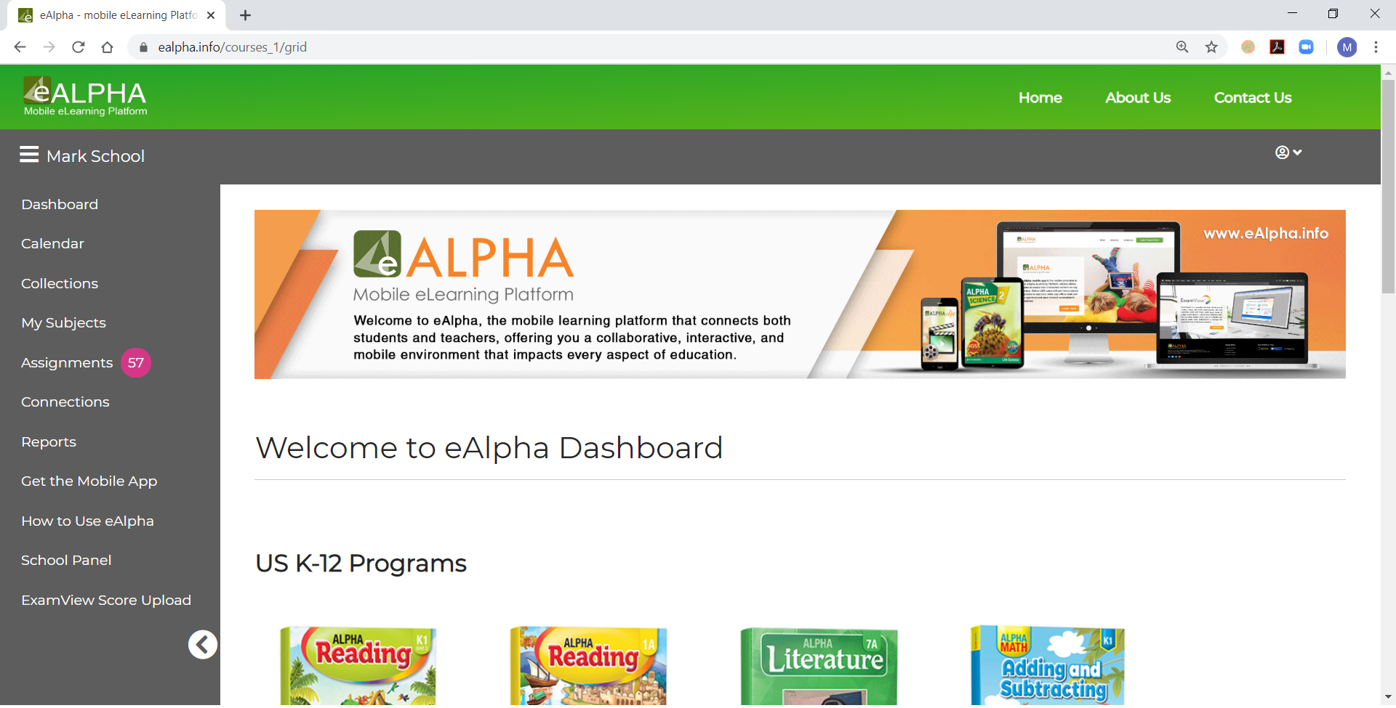
You can now show the lessons within eAlpha and your students will see the lessons. You can use your audio to speak to the students and they can use their audio to speak to you.
Notes:
Good morning, thank you for attending Alpha Publishing’s presentation on No internet, No problem – our solution to schools’ poor internet connectivity in many regions in which we operate.

Slide 14
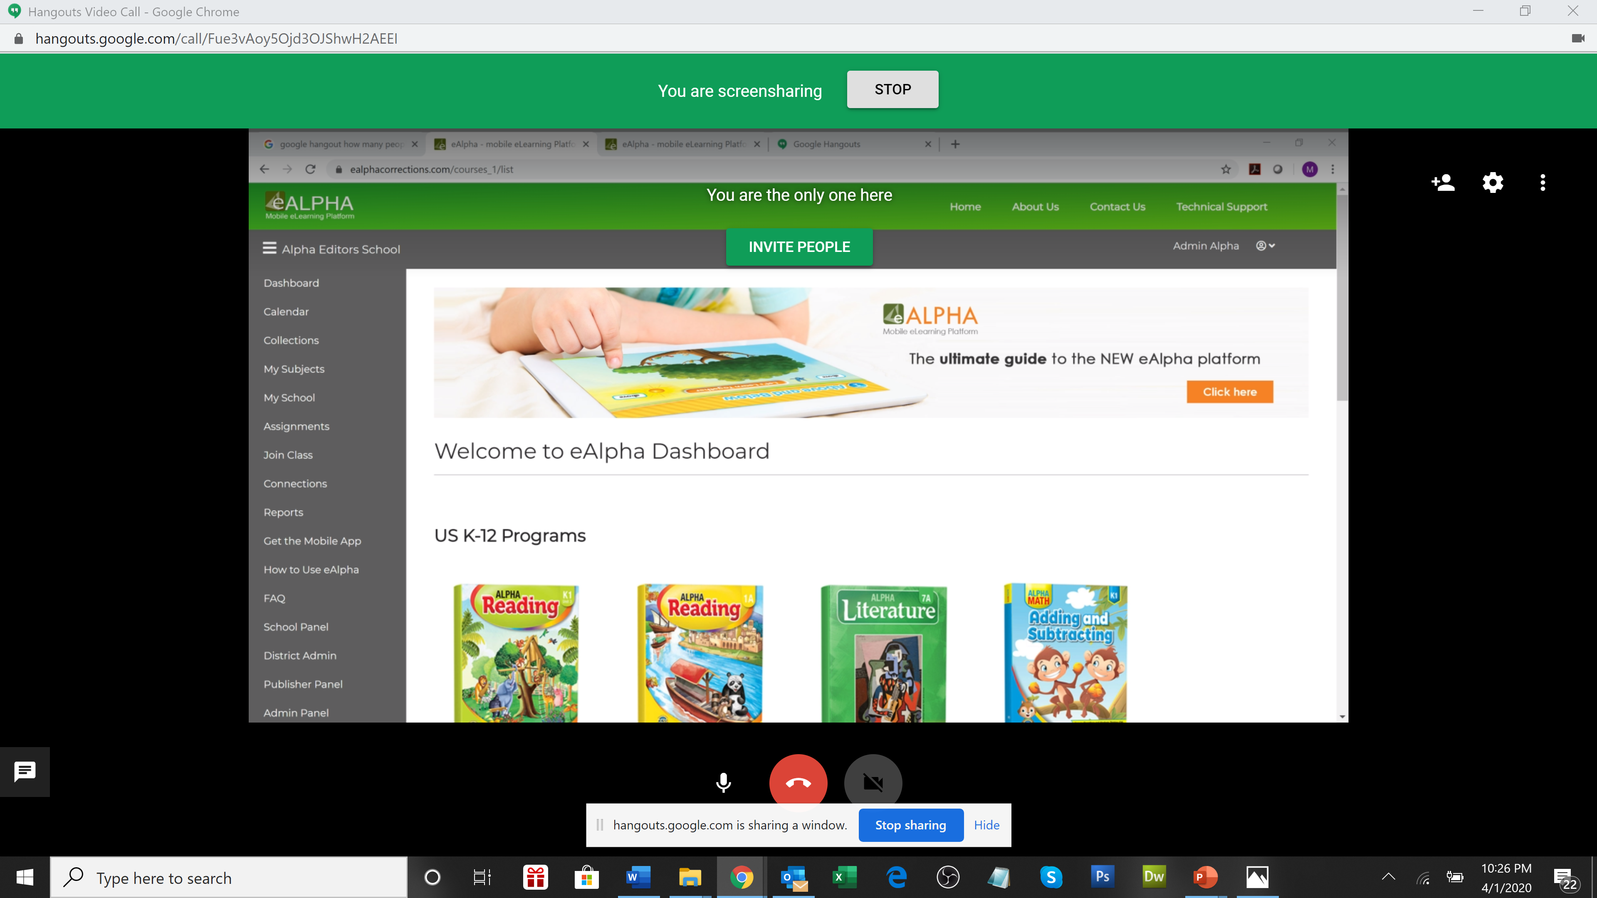
Click on Stop in the green banner at the top to stop sharing the screen
Notes:
Good morning, thank you for attending Alpha Publishing’s presentation on No internet, No problem – our solution to schools’ poor internet connectivity in many regions in which we operate.

Slide 15
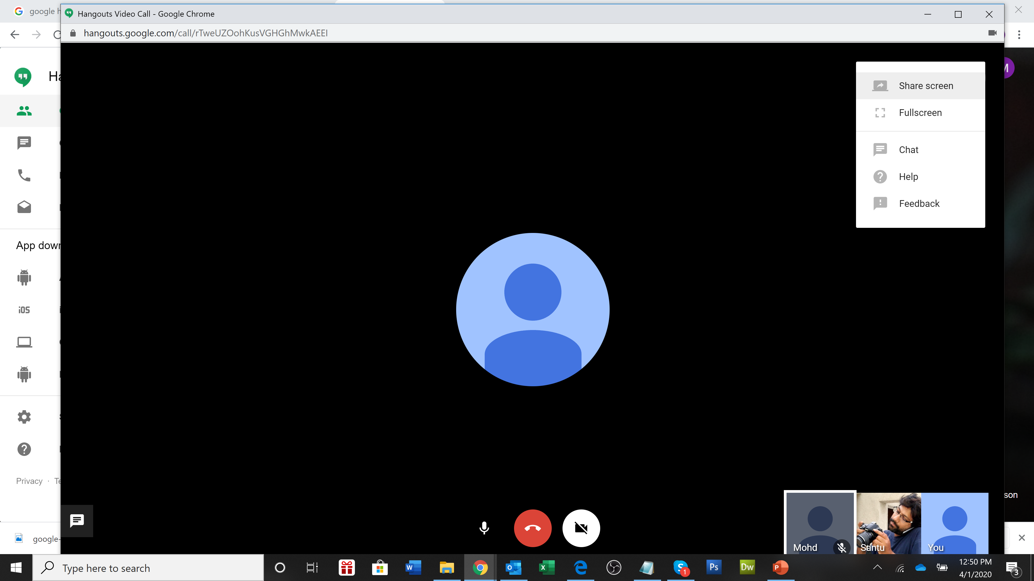
Select Chat at the bottom of the screen
Notes:
Good morning, thank you for attending Alpha Publishing’s presentation on No internet, No problem – our solution to schools’ poor internet connectivity in many regions in which we operate.

Slide 16
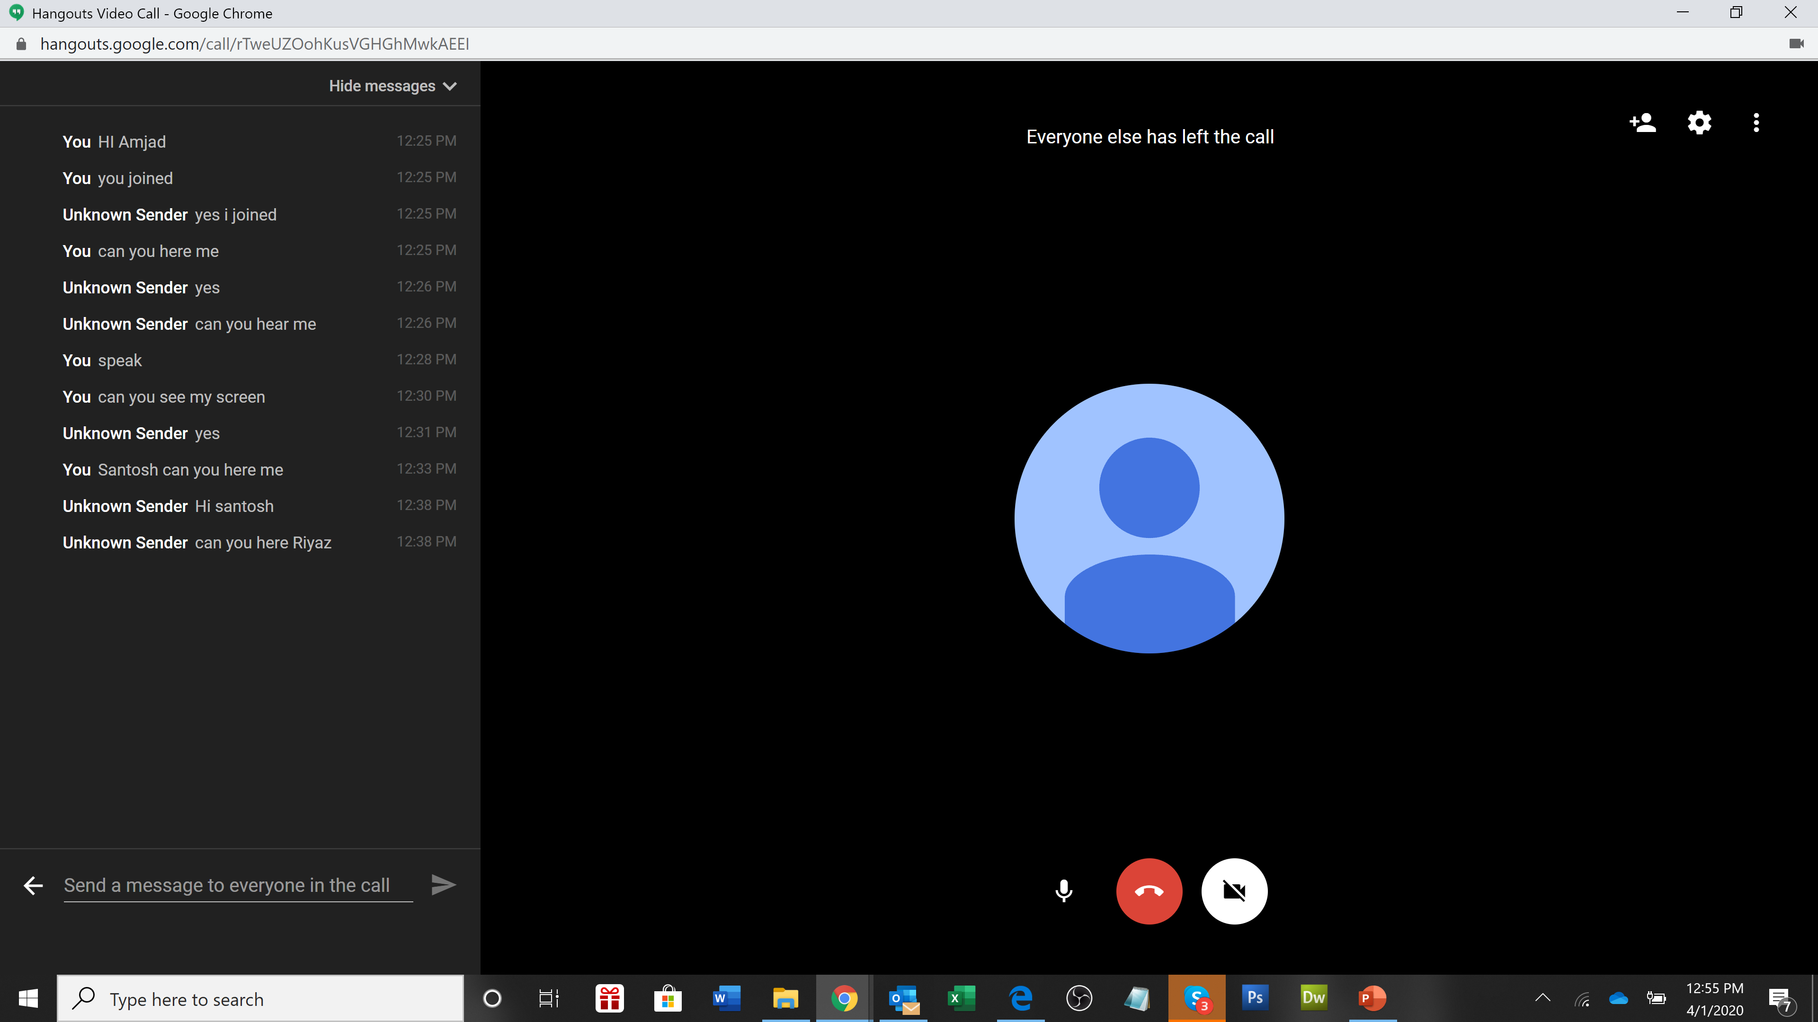
You can now see the chat box – here you and the students can send messages to each other during the lesson
Notes:
Good morning, thank you for attending Alpha Publishing’s presentation on No internet, No problem – our solution to schools’ poor internet connectivity in many regions in which we operate.

Slide 17
Thank you
Notes:
Good morning, thank you for attending Alpha Publishing’s presentation on No internet, No problem – our solution to schools’ poor internet connectivity in many regions in which we operate.

